Slide 1
Unmanned Aerial Systems for Geological Survey
Ryan Olsen
30 November 2020
ES 365

Slide 2
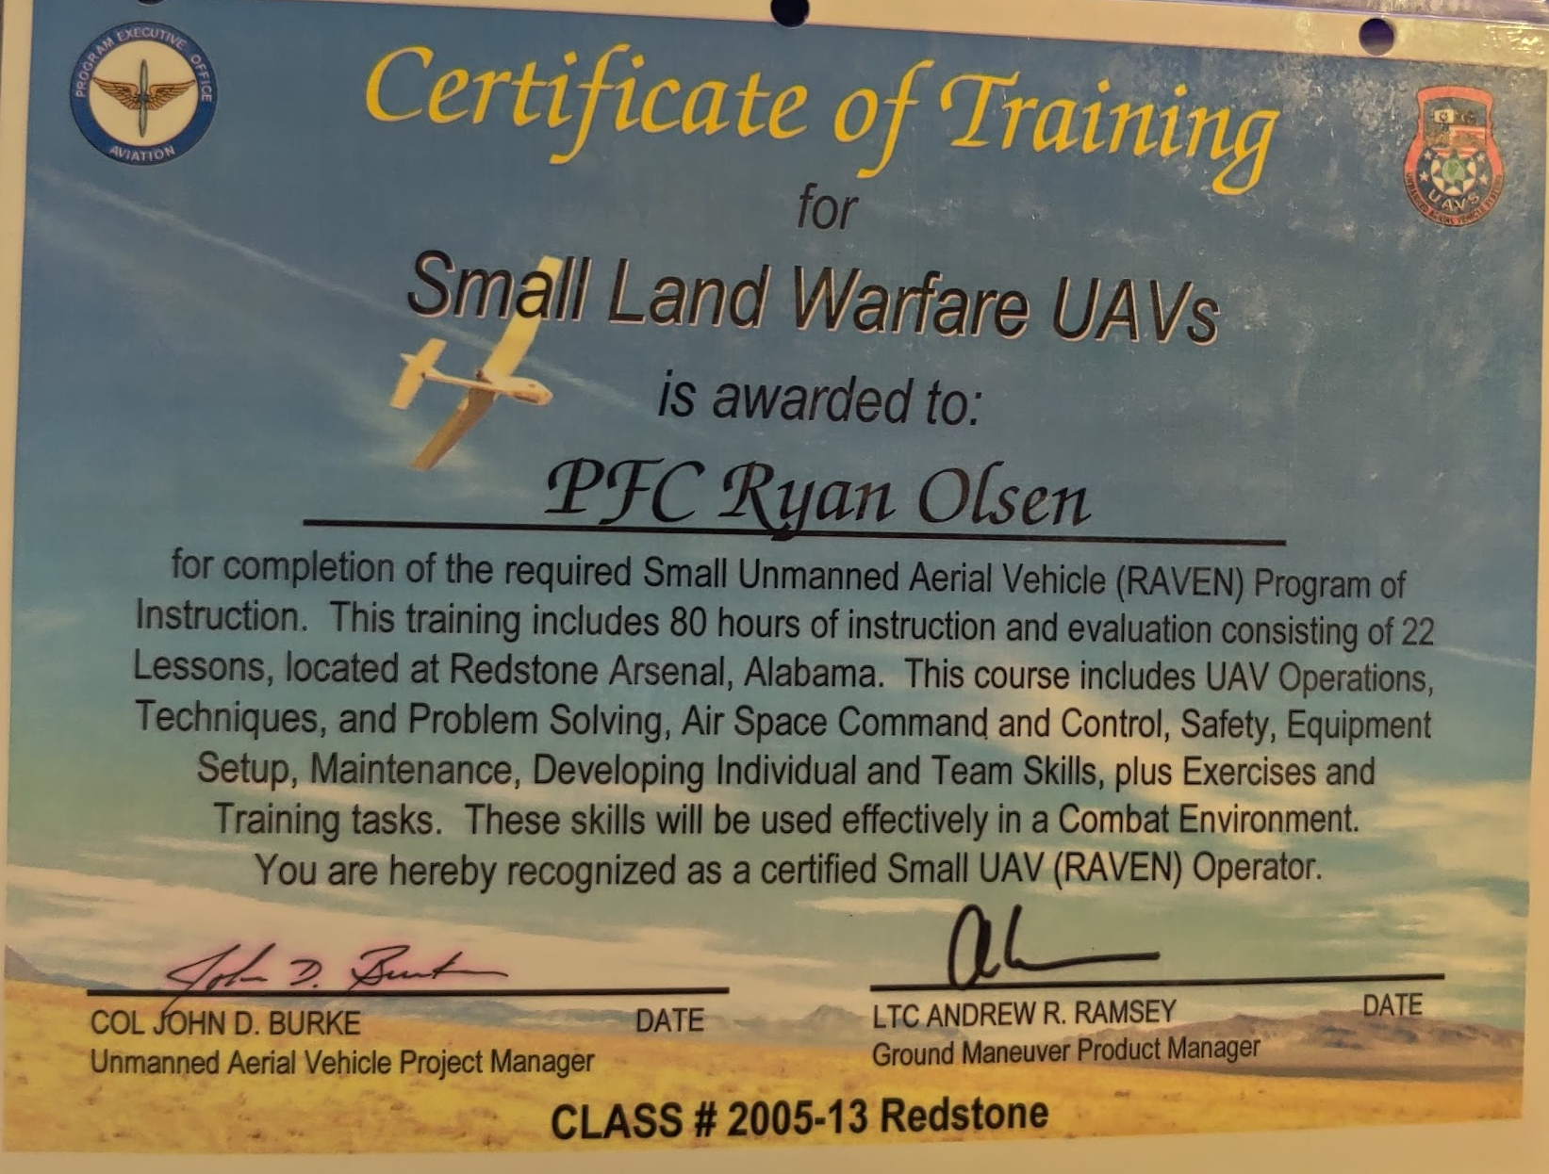
Introduction
Advantages
Disadvantages
Applications
Types of UAS
Sensor Packages
Conclusion

Slide 3
What is a UAS?
Per 14 C.F.R. §107.3:
Small unmanned aircraft means an unmanned aircraft weighing less than 55 pounds on takeoff, including everything that is on board or otherwise attached to the aircraft.
Small unmanned aircraft system (small UAS) means a small unmanned aircraft and its associated elements (including communication links and the components that control the small unmanned aircraft) that are required for the safe and efficient operation of the small unmanned aircraft in the national airspace system.

Slide 4
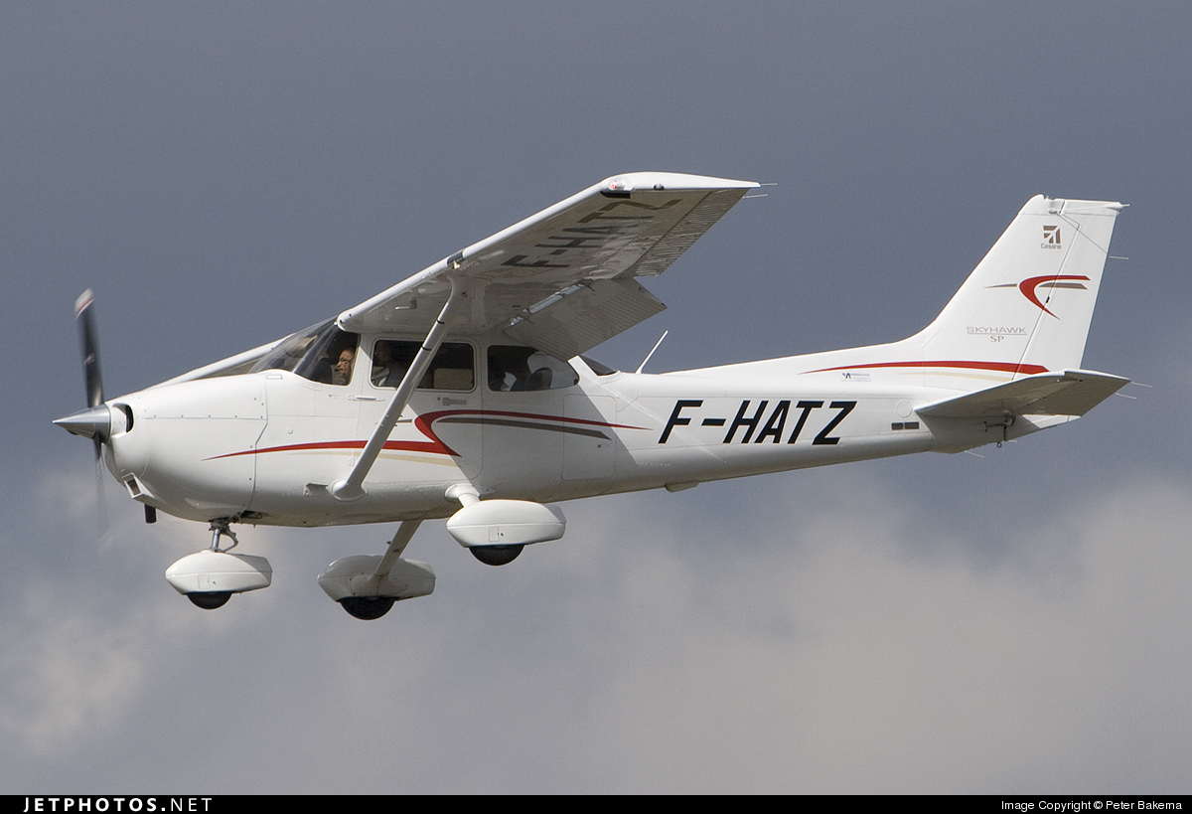
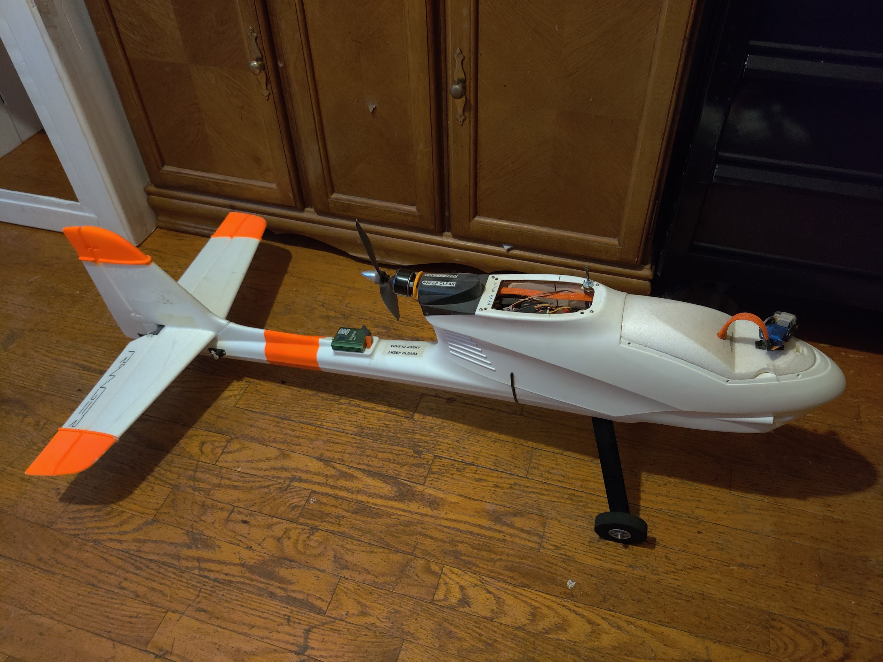
Advantages
UAS are much cheaper to procure, operate, and maintain than manned aircraft.
Peter Bakema, 2010. https://www.jetphotos.com/photo/6817606
Ryan Olsen, 2020
Type | Cessna 172 | Hobby UAS
Buy cost | ~$156,000₁ | ~$2000
Avg cost per operating hour | $251.38 | ~$0.07
Yearly budget | $113,120.00 | ~$150
1: Averaged cost of all Cessna 172 models listed on https://www.trade-a-plane.com/ as of 30 Nov 2020 Cessna 172 hourly rate and budget from Aircraft Cost Calculator, 2019.

Slide 5
Advantages
UAS do not require extensive training to get licenced
Manned Aircraft | UAS
Per 14 C.F.R. §61.3: (a) Required pilot certificate for operating a civil aircraft of the United States. No person may serve as a required pilot flight crewmember of a civil aircraft of the United States, unless that person: (1) Has in the person's physical possession or readily accessible in the aircraft when exercising the privileges of that pilot certificate or authorization— (i) A pilot certificate issued under this part and in accordance with §61.19; (ii) A special purpose pilot authorization issued under §61.77; (iii) A temporary certificate issued under §61.17; (iv) A document conveying temporary authority to exercise certificate privileges issued by the Airmen Certification Branch under §61.29(e); (v) When engaged in a flight operation within the United States for a part 119 certificate holder authorized to conduct operations under part 121 or 135 of this chapter, a temporary document provided by that certificate holder under an approved certificate verification plan; (vi) When engaged in a flight operation within the United States for a fractional ownership program manager authorized to conduct operations under part 91, subpart K, of this chapter, a temporary document provided by that program manager under an approved certificate verification plan; or (vii) When operating an aircraft within a foreign country, a pilot license issued by that country may be used. (2) Has a photo identification that is in that person's physical possession or readily accessible in the aircraft when exercising the privileges of that pilot certificate or authorization. The photo identification must be a: (i) Driver's license issued by a State, the District of Columbia, or territory or possession of the United States; (ii) Government identification card issued by the Federal government, a State, the District of Columbia, or a territory or possession of the United States; (iii) U.S. Armed Forces' identification card; (iv) Official passport; (v) Credential that authorizes unescorted access to a security identification display area at an airport regulated under 49 CFR part 1542; or (vi) Other form of identification that the Administrator finds acceptable. (b) Required pilot certificate for operating a foreign-registered aircraft within the United States. No person may serve as a required pilot flight crewmember of a civil aircraft of foreign registry within the United States, unless— (1) That person's pilot certificate or document issued under §61.29(e) is in that person's physical possession or readily accessible in the aircraft when exercising the privileges of that pilot certificate; and (2) Has been issued in accordance with this part, or has been issued or validated by the country in which the aircraft is registered. (c) Medical certificate. (1) A person may serve as a required pilot flight crewmember of an aircraft only if that person holds the appropriate medical certificate issued under part 67 of this chapter, or other documentation acceptable to the FAA, that is in that person's physical possession or readily accessible in the aircraft. Paragraph (c)(2) of this section provides certain exceptions to the requirement to hold a medical certificate. (2) A person is not required to meet the requirements of paragraph (c)(1) of this section if that person— (i) Is exercising the privileges of a student pilot certificate while seeking a pilot certificate with a glider category rating, a balloon class rating, or glider or balloon privileges; (ii) Is exercising the privileges of a student pilot certificate while seeking a sport pilot certificate with other than glider or balloon privileges and holds a U.S. driver's license; (iii) Is exercising the privileges of a student pilot certificate while seeking a pilot certificate with a weight-shift-control aircraft category rating or a powered parachute category rating and holds a U.S. driver's license; (iv) Is exercising the privileges of a sport pilot certificate with glider or balloon privileges; (v) Is exercising the privileges of a sport pilot certificate with other than glider or balloon privileges and holds a U.S. driver's license. A person who has applied for or held a medical certificate may exercise the privileges of a sport pilot certificate using a U.S. driver's license only if that person— (A) Has been found eligible for the issuance of at least a third-class airman medical certificate at the time of his or her most recent application; and (B) Has not had his or her most recently issued medical certificate suspended or revoked or most recent Authorization for a Special Issuance of a Medical Certificate withdrawn. (vi) Is holding a pilot certificate with a balloon class rating and is piloting or providing training in a balloon as appropriate; (vii) Is holding a pilot certificate or a flight instructor certificate with a glider category rating, and is piloting or providing training in a glider, as appropriate; (viii) Is exercising the privileges of a flight instructor certificate, provided the person is not acting as pilot in command or as a required pilot flight crewmember; (ix) Is exercising the privileges of a ground instructor certificate; (x) Is operating an aircraft within a foreign country using a pilot license issued by that country and possesses evidence of current medical qualification for that license; (xi) Is operating an aircraft with a U.S. pilot certificate, issued on the basis of a foreign pilot license, issued under §61.75, and holds a medical certificate issued by the foreign country that issued the foreign pilot license, which is in that person's physical possession or readily accessible in the aircraft when exercising the privileges of that airman certificate; (xii) Is a pilot of the U.S. Armed Forces, has an up-to-date U.S. military medical examination, and holds military pilot flight status; (xiii) Is exercising the privileges of a student, recreational or private pilot certificate for operations conducted under the conditions and limitations set forth in §61.113(i) and holds a U.S. driver's license; or (xiv) Is exercising the privileges of a flight instructor certificate and acting as pilot in command for operations conducted under the conditions and limitations set forth in §61.113(i) and holds a U.S. driver's license. (d) Flight instructor certificate. (1) A person who holds a flight instructor certificate issued under this part must have that certificate, or other documentation acceptable to the Administrator, in that person's physical possession or readily accessible in the aircraft when exercising the privileges of that flight instructor certificate. (2) Except as provided in paragraph (d)(3) of this section, no person other than the holder of a flight instructor certificate issued under this part with the appropriate rating on that certificate may— (i) Give training required to qualify a person for solo flight and solo cross-country flight; (ii) Endorse an applicant for a— (A) Pilot certificate or rating issued under this part; (B) Flight instructor certificate or rating issued under this part; or (C) Ground instructor certificate or rating issued under this part; (iii) Endorse a pilot logbook to show training given; or (iv) Endorse a logbook for solo operating privileges. (3) A flight instructor certificate issued under this part is not necessary— (i) Under paragraph (d)(2) of this section, if the training is given by the holder of a commercial pilot certificate with a lighter-than-air rating, provided the training is given in accordance with the privileges of the certificate in a lighter-than-air aircraft; (ii) Under paragraph (d)(2) of this section, if the training is given by the holder of an airline transport pilot certificate with a rating appropriate to the aircraft in which the training is given, provided the training is given in accordance with the privileges of the certificate and conducted in accordance with an approved air carrier training program approved under part 121 or part 135 of this chapter; (iii) Under paragraph (d)(2) of this section, if the training is given by a person who is qualified in accordance with subpart C of part 142 of this chapter, provided the training is conducted in accordance with an approved part 142 training program; (iv) Under paragraphs (d)(2)(i), (d)(2)(ii)(C), and (d)(2)(iii) of this section, if the training is given by the holder of a ground instructor certificate in accordance with the privileges of the certificate; or (v) Under paragraph (d)(2)(iii) of this section, if the training is given by an authorized flight instructor under §61.41 of this part. (e) Instrument rating. No person may act as pilot in command of a civil aircraft under IFR or in weather conditions less than the minimums prescribed for VFR flight unless that person holds: (1) The appropriate aircraft category, class, type (if required), and instrument rating on that person's pilot certificate for any airplane, helicopter, or powered-lift being flown; (2) An airline transport pilot certificate with the appropriate aircraft category, class, and type rating (if required) for the aircraft being flown; (3) For a glider, a pilot certificate with a glider category rating and an airplane instrument rating; or (4) For an airship, a commercial pilot certificate with a lighter-than-air category rating and airship class rating. (f) Category II pilot authorization. Except for a pilot conducting Category II operations under part 121 or part 135, a person may not: (1) Act as pilot in command of a civil aircraft during Category II operations unless that person— (i) Holds a Category II pilot authorization for that category or class of aircraft, and the type of aircraft, if applicable; or (ii) In the case of a civil aircraft of foreign registry, is authorized by the country of registry to act as pilot in command of that aircraft in Category II operations. (2) Act as second in command of a civil aircraft during Category II operations unless that person— (i) Holds a pilot certificate with category and class ratings for that aircraft and an instrument rating for that category aircraft; (ii) Holds an airline transport pilot certificate with category and class ratings for that aircraft; or (iii) In the case of a civil aircraft of foreign registry, is authorized by the country of registry to act as second in command of that aircraft during Category II operations. (g) Category III pilot authorization. Except for a pilot conducting Category III operations under part 121 or part 135, a person may not: (1) Act as pilot in command of a civil aircraft during Category III operations unless that person— (i) Holds a Category III pilot authorization for that category or class of aircraft, and the type of aircraft, if applicable; or (ii) In the case of a civil aircraft of foreign registry, is authorized by the country of registry to act as pilot in command of that aircraft in Category III operations. (2) Act as second in command of a civil aircraft during Category III operations unless that person— (i) Holds a pilot certificate with category and class ratings for that aircraft and an instrument rating for that category aircraft; (ii) Holds an airline transport pilot certificate with category and class ratings for that aircraft; or (iii) In the case of a civil aircraft of foreign registry, is authorized by the country of registry to act as second in command of that aircraft during Category III operations. (h) Category A aircraft pilot authorization. The Administrator may issue a certificate of authorization for a Category II or Category III operation to the pilot of a small aircraft that is a Category A aircraft, as identified in §97.3(b)(1) of this chapter if: (1) The Administrator determines that the Category II or Category III operation can be performed safely by that pilot under the terms of the certificate of authorization; and (2) The Category II or Category III operation does not involve the carriage of persons or property for compensation or hire. (i) Ground instructor certificate. (1) Each person who holds a ground instructor certificate issued under this part must have that certificate or a temporary document issued under §61.29(e) in that person's physical possession or immediately accessible when exercising the privileges of that certificate. (2) Except as provided in paragraph (i)(3) of this section, no person other than the holder of a ground instructor certificate, issued under this part or part 143, with the appropriate rating on that certificate may— (i) Give ground training required to qualify a person for solo flight and solo cross-country flight; (ii) Endorse an applicant for a knowledge test required for a pilot, flight instructor, or ground instructor certificate or rating issued under this part; or (iii) Endorse a pilot logbook to show ground training given. (3) A ground instructor certificate issued under this part is not necessary— (i) Under paragraph (i)(2) of this section, if the training is given by the holder of a flight instructor certificate issued under this part in accordance with the privileges of that certificate; (ii) Under paragraph (i)(2) of this section, if the training is given by the holder of a commercial pilot certificate with a lighter-than-air rating, provided the training is given in accordance with the privileges of the certificate in a lighter-than-air aircraft; (iii) Under paragraph (i)(2) of this section, if the training is given by the holder of an airline transport pilot certificate with a rating appropriate to the aircraft in which the training is given, provided the training is given in accordance with the privileges of the certificate and conducted in accordance with an approved air carrier training program approved under part 121 or part 135 of this chapter; (iv) Under paragraph (i)(2) of this section, if the training is given by a person who is qualified in accordance with subpart C of part 142 of this chapter, provided the training is conducted in accordance with an approved part 142 training program; or (v) Under paragraph (i)(2)(iii) of this section, if the training is given by an authorized flight instructor under §61.41 of this part. (j) Age limitation for certain operations. (1) Age limitation. No person who holds a pilot certificate issued under this part may serve as a pilot on a civil airplane of U.S. registry in the following operations if the person has reached his or her 60th birthday or, in the case of operations with more than one pilot, his or her 65th birthday: (i) Scheduled international air services carrying passengers in turbojet-powered airplanes; (ii) Scheduled international air services carrying passengers in airplanes having a passenger-seat configuration of more than nine passenger seats, excluding each crewmember seat; (iii) Nonscheduled international air transportation for compensation or hire in airplanes having a passenger-seat configuration of more than 30 passenger seats, excluding each crewmember seat; or (iv) Scheduled international air services, or nonscheduled international air transportation for compensation or hire, in airplanes having a payload capacity of more than 7,500 pounds. (2) Definitions. (i) “International air service,” as used in this paragraph (j), means scheduled air service performed in airplanes for the public transport of passengers, mail, or cargo, in which the service passes through the airspace over the territory of more than one country. (ii) “International air transportation,” as used in this paragraph (j), means air transportation performed in airplanes for the public transport of passengers, mail, or cargo, in which the service passes through the airspace over the territory of more than one country. (k) Special purpose pilot authorization. Any person that is required to hold a special purpose pilot authorization, issued in accordance with §61.77 of this part, must have that authorization and the person's foreign pilot license in that person's physical possession or have it readily accessible in the aircraft when exercising the privileges of that authorization. (l) Inspection of certificate. Each person who holds an airman certificate, temporary document in accordance with paragraph (a)(1)(v) or (vi) of this section, medical certificate, documents establishing alternative medical qualification under part 68 of this chapter, authorization, or license required by this part must present it and their photo identification as described in paragraph (a)(2) of this section for inspection upon a request from: (1) The Administrator; (2) An authorized representative of the National Transportation Safety Board; (3) Any Federal, State, or local law enforcement officer; or (4) An authorized representative of the Transportation Security Administration. | Per 14 C.F.R. §107.65: (a) Passed an initial aeronautical knowledge test covering the areas of knowledge specified in §107.73(a); (b) Passed a recurrent aeronautical knowledge test covering the areas of knowledge specified in §107.73(b); or (c) If a person holds a pilot certificate (other than a student pilot certificate) issued under part 61 of this chapter and meets the flight review requirements specified in §§61.56, passed either an initial or recurrent training course covering the areas of knowledge specified in §107.74(a) or (b) in a manner acceptable to the Administrator.

Slide 6
Advantages
In addition to lower cost and ease of licensing, UAS also have the following benefits:
An airfield is not required, often can be hand launched
The UAS can be transported directly to and flown from the area of interest, reducing lead time for data recovery
UAS can use lower cost, lower resolution sensors to gather equivalent data since they fly lower, slower, or can hover over a point of interest
Their small size means quieter operation, less likely to disturb animals or people
Can be preprogrammed to fly a set pattern using GPS.

Slide 7
Disadvantages
While UAS are easier to operate than manned aircraft, in the United States, the Federal Aviation Administration regulates UAS operation through 14 C.F.R. §107. The main restrictions are:
The UAS must be registered (14 C.F.R. §107.13)
UAS operation must occur in daylight hours (14 C.F.R. §107.29)
UAS operator or a designated observer must maintain line of sight with UAS (14 C.F.R. §107.31, 33)
Airspace restrictions (14 C.F.R. §107.37-47)
Speed, altitude, and weather restrictions (14 C.F.R. §107.51)
There is no international standard for UAS operation

Slide 8
Disadvantages
There is a lack of maintenance requirements for UAS operation. What is considered safe for operation is a judgement call for the operator.
Per 14 C.F.R. §107.15:
(a) No person may operate a civil small unmanned aircraft system unless it is in a condition for safe operation. Prior to each flight, the remote pilot in command must check the small unmanned aircraft system to determine whether it is in a condition for safe operation.
(b) No person may continue flight of the small unmanned aircraft when he or she knows or has reason to know that the small unmanned aircraft system is no longer in a condition for safe operation.

Slide 9
Disadvantages
Regulations are not the only disadvantages. The following must be taken into consideration when comparing UAS to manned aircraft:
The small size of UAS means they are more susceptible to weather
Shorter range and less flight time than manned aircraft
May be attacked by wildlife
May be shot at by locals due to privacy concerns
Operators may be susceptible to spatial disorientation due to a difference in what they see versus what they feel

Slide 10
Applications
UAS are a flexible platform and may be used for almost any task that a manned aircraft could be used for, they are also ideal for tasks where a larger aircraft may be unsafe or cause too much disturbance to gather accurate data:
Infrastructure inspection:
Bridge inspection (Gillins et al.,2016)
Wildlife management and tracking:
(Linchant et al., 2015)
Mapping and geological survey:
Landslide mapping (Casagli et al., 2017)
(Singh and Frazier, 2017)
Agricultural monitoring:
Crop drainage (Allred et al., 2020)
Natural and manmade hazard analysis and prediction:
Landslide early warning (Casagli et al., 2017)
Landmine detection (Šipoš and Dušan, 2020)
(Watts et al., 2010)
Magnetic survey (Wood et al., 2016)
Search and Rescue

Slide 11
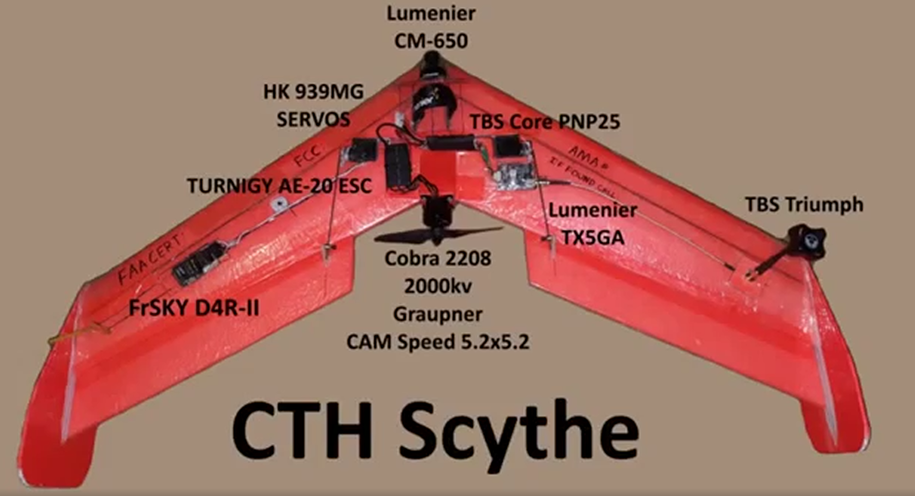
Types of UAS
UAS broadly fit into two categories, the first being fixed wing.
Generally conventional airplane layout
Wings provide lift
Generally longer range and flight time
Heavier payloads don’t affect flight time as much as other types
Ryan Olsen, 2020
Ryan Olsen, 2016

Slide 12
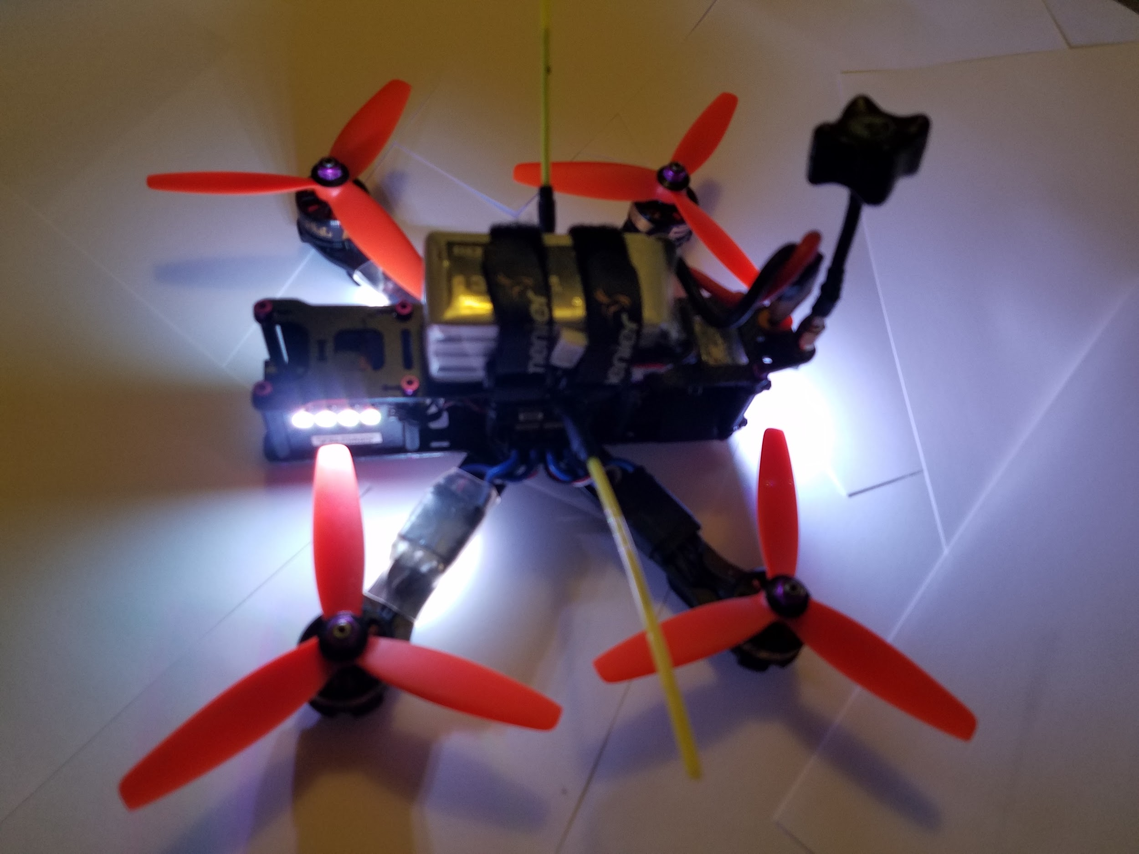
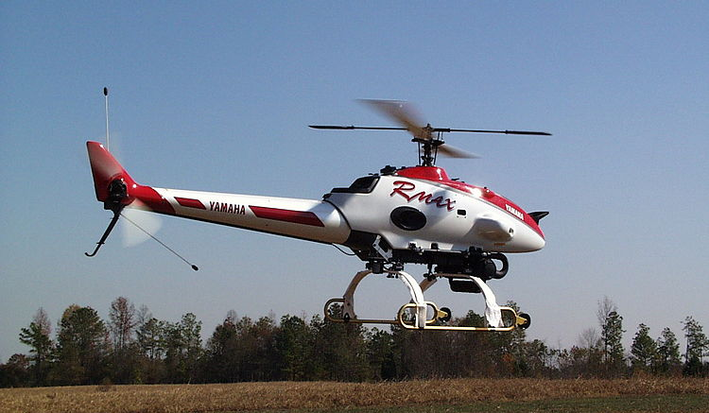
Types of UAS
The second broad type of UAS is the rotary wing type
Helicopter or multicopter layout
Lift is generated by spinning propellers or rotors
Generally shorter range and flight time
Heavier payloads greatly affect flight time
Can hover
Helicopter: Mechanically complex
Multicopter: Electronically complex
Ryan Olsen, 2017
Gtuav, 2014. https://commons.wikimedia.org/wiki/File:YamahaRMax.jpg

Slide 13
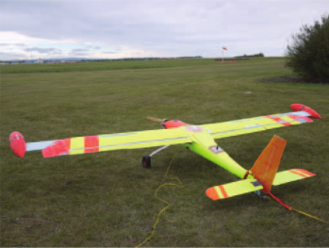
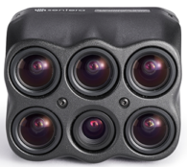
Sensor Packages
The primary sensors carried by UAS are typically visual, however almost any non-contact and some types of contact sensors can be utilized:
Color/IR/NIR/UV or multispectral cameras
Ground mapping RADAR
(Šipoš and Dušan, 2020)
Magnetometer
(Wood et al., 2016)
Air sampling instruments
Water sampling instruments
Woods et al., 2016. Experimental aeromagnetic survey using an unmanned air system
Sentera, Inc., 2019. 6x multispectral camera, https://sentera.com/6x/

Slide 14
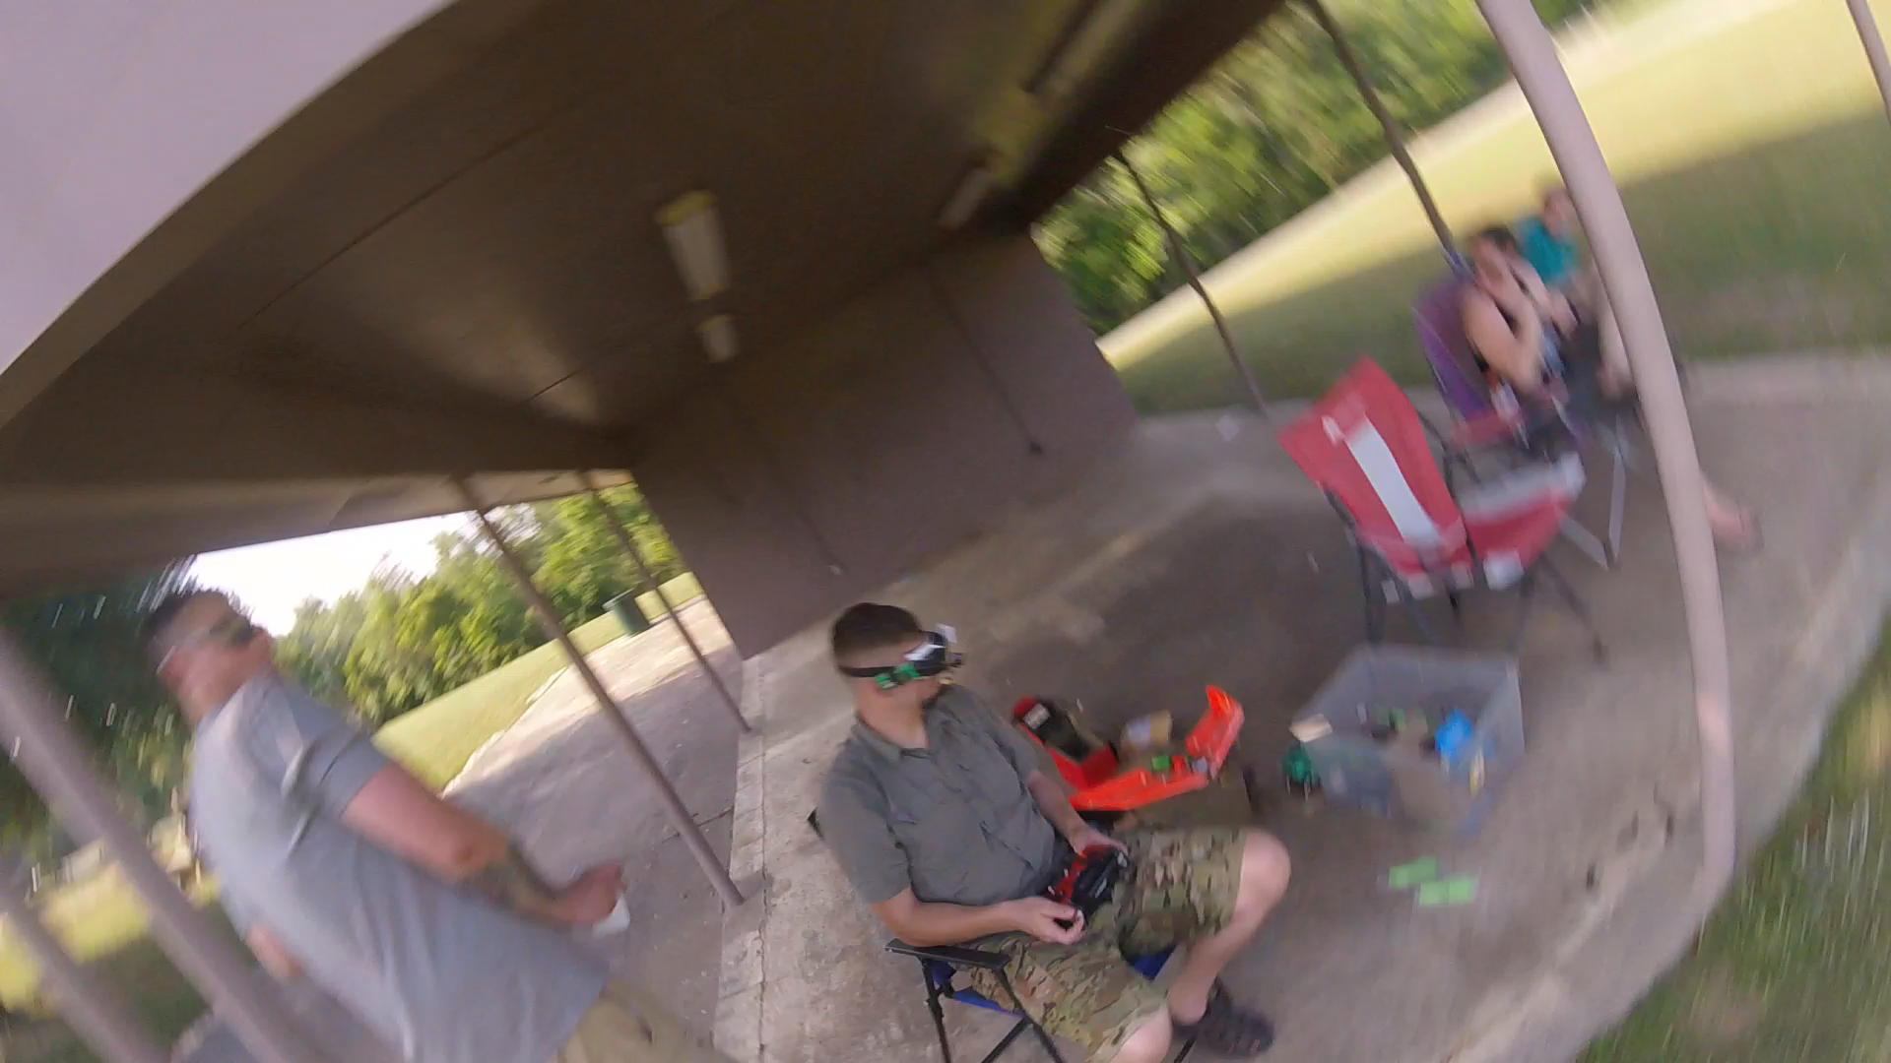
Introduction
Advantages
Lower barrier to entry
Flexibility
Disadvantages
Operating restrictions
Applications
Almost anything
Types of UAS
Fixed wing
Rotary wing
Sensor Packages
Mostly visual
Conclusion
Ryan Olsen, 2016.
My YouTube channel, videos of me flying my FPV multicopter and sometimes crashing:
https://www.youtube.com/channel/UCNPjje8BcAlz5P_1Y9auKJA

Slide 15
References
Allred, B., Martinez, L., Fessehazion, M. K., Rouse, G., Williamson, T. N., Wishart, D., Koganti, T., Freeland, R., Eash, N., Batschelet, A., Featheringill, R., 2020. Overall results and key findings on the use of UAV visible-color, multispectral, and thermal infrared imagery to map agricultural drainage pipes. Agricultural Water Management. 232,
Aircraft Cost Calculator, 2019. CESSNA 172R Price and Operating Costs. <https://www.aircraftcostcalculator.com/AircraftOperatingCosts/327/Cessna+172R>, accessed November 30, 2020.
Austin R., 2010. Unmanned aircraft systems : UAVS design, development and deployment. John Wiley and Sons, 322 pp.
Casagli, N., Frodella, W., Morelli, S., Tofani, V., Ciampalini, A., Intrieri, E., Raspini, F., Rossi, G., Tanteri, L., Lu, P., 2017, Spaceborne, UAV and ground-based remote sensing techniques for landslide mapping, monitoring and early warning. Geoenvironmental Disasters. 4:9.
Gillins, M. N., Gillins, D. T., Parrish, C., 2016, Cost-Effective Bridge Safety Inspections Using Unmanned Aircraft Systems (UAS). Geotechnical and Structural Engineering Congress 2016. Phoenix, Arizona, February 14–17, 2016. American Society of Civil Engineers.
Gupta, S. G., Ghonge, M. M., Jawandhiya, P. M., 2013, Review of Unmanned Aircraft System (UAS). International Journal of Advanced Research in Computer Engineering & Technology (IJARCET). 2:4, 1646-1658
Linchant, J., Lisein, J., Semeki, J., Lejeune, P., Vermeulen, C,, 2015, Are unmanned aircraft systems (UASs) the future of wildlife monitoring? A review of accomplishments and challenges. Mammal Review. 243, 239-252.
SMALL UNMANNED AIRCRAFT SYSTEMS, 14 C.F.R. § 107 Part C (2020)
Singh, K. K., Frazier, A. E., 2017, A meta-analysis and review of unmanned aircraft system (UAS) imagery for terrestrial applications. INTERNATIONAL JOURNAL OF REMOTE SENSING. 39:15-16, 5078-5098.
Šipoš, D., Dušan G., 2020, A Lightweight and Low-Power UAV-Borne Ground Penetrating Radar Design for Landmine Detection. Sensors. 20:8, 2234
Watts, A.C., Perry, J. H., Smith, S. E., Burgess, M. A., Wilkinson, B. E., Szantoi, Z., Ifju, P. G., Percival, H. F., 2010, Small Unmanned Aircraft Systems for Low-Altitude Aerial Surveys. Journal of Wildlife Management. 74:7, 1614-1619.
Wood, A., Cook, I., Doyle, B., Cunningham, M., Samson, C., 2016, Experimental aeromagnetic survey using an unmanned air system. Society of Exploration Geophysicists. 35:3, 270-273

